Slide 1
CS162 Operating Systems and Systems Programming Lecture 14 Caching (Finished), Demand Paging
March 12th, 2018
Profs. Anthony D. Joseph & Jonathan Ragan-Kelley
http://cs162.eecs.Berkeley.edu
[substitute Prof. David E. Culler]
Notes:
Ok, so let’s get started! This is lecture 14 and I will continue talking about caching, picking up where Anthony left off on Monday.
And towards the end of the lecture, I will introduce demand paging, which is also a form of caching.

Slide 2
Tribute
Sir Maurice Wilkes, inventor of EDSAC, Microprogramming, and the Translation Look-aside Buffer

Slide 3
Recall: Caching Concept
Cache: a repository for copies that can be accessed more quickly than the original
Make frequent case fast and infrequent case less dominant
Caching underlies many techniques used today to make computers fast
Can cache: memory locations, address translations, pages, file blocks, file names, network routes, etc…
Notes:
Ok, so as I said, this lecture is really about accelerating accesses. We will try to optimize anything and everything we can to achieve that.
Let’s start with recalling some of the concepts Anthony talked about in the last lecture.
Actually, the concept of caching might go back to your 61C or even 61A, where it was first introduced to you.
In simple words, Cache is a repository for copies that can be accessed more quickly than the original.
And I like this idea here in this picture, we have a desk where we place documents, pages that we need to access more frequently on the desk, and infrequently we need to get up, go to the cabinet to fetch a new file or something.
Well, that is the key thing about caching: make frequent cases fast, and infrequent cases less dominant/less expensive.
In our world, we see cache behind many techniques to make systems fast. We can cache memory locations, address translations, pages, file names, blocks, network routes, for instance.

Slide 4
Big Really Basic Concept #1
“Large” memories are “slow”, “Fast” memories are “small”
How do we create the illusion of a ”large fast” memory? – on average.

Slide 5
Recall: In Machine Structures (eg. 61C) …
100ns
Caching is the key to memory system performance
Main
Memory
(DRAM)
Processor
Access time = 100ns
Main
Memory
(DRAM)
Second
Level
Cache
(SRAM)
Processor
10ns
100ns
Average Access time=(Hit Rate x HitTime) + (Miss Rate x MissTime)
HitRate + MissRate = 1
HitRate = 90% => Avg. Access Time=(0.9 x 10) + (0.1 x 100)=19ns
HitRate = 99% => Avg. Access Time=(0.99 x 10) + (0.01 x 100)=10.9 ns
Notes:
So, the role of a cache is to reduce the average memory access time. So, here we have a processor; if it directly needs to go to memory to access something, it takes 100ns.
Remember, processors are superfast, they compute in small cycles, and hence 100ns is a really long time for them.
If we add a second level cache, we can instead access the same data in 10ns, i.e.,10 times faster than directly going to memory.
To quantify the gain due to a cache, we can compute the average access time: and its simply the hit-rate (times we find it in the cache). …
So, we get an illusion that we can access the main memory at such a fast speed, due to caching.

Slide 6
Big Really Really Basic Concept #2
How many distinct values can be expressed in K bits?
How many addresses can be expressed in K bits?
How large a “namespace” can be addressed by N bits?
K bits
address
2^{K} addresses
K
“datum”
Address Space

Slide 7
Big Basic Concept #3
A program operates in a Virtual Address Space distinct from the Physical Address Space of the hardware in the machine.
Virtual Address Space
Physical Address Space
2³⁸
~ 256×10⁹
2⁶⁴
~ 1.8×10¹⁹
Virtual address
map
Physical address
64 bits
38 bits
?

Slide 8
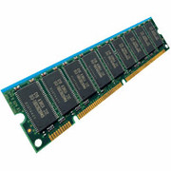
Recall: How is the Translation Accomplished?
Virtual
Addresses
Physical
Addresses
CPU
MMU
What, exactly happens inside MMU?
Hardware Tree Traversal
For each virtual address traverses the page table in hardware
Generates a “Page Fault” if it encounters invalid PTE
Fault handler will decide what to do
More on this next lecture
Pros: Relatively fast (but still many memory accesses!)
Cons: Inflexible, Complex hardware
Another possibility: Software
Each traversal done in software
Pros: Very flexible
Cons: Every translation must invoke Fault!
In fact, need way to cache translations for either case!

Slide 9
How to map VA => PA ?
What should be the unit of mapping? How?
How many?
Virtual addr 0
Physical addr 0
Virtual addr 1
Physical addr 1
Virtual addr m-1
Physical addr m-1
Virtual address
map
Physical address
64 bits
38 bits
?

Slide 10
Caching Applied to Address Translation
Virtual
Address
TLB
Physical
Memory
CPU
Physical
Address
Cached?
Yes
No
Save
Result
Translate
(MMU)
Data Read or Write
(untranslated)
Question is one of page locality: does it exist?
Instruction accesses spend a lot of time on the same page (since accesses sequential)
Stack accesses have definite locality of reference
Data accesses have less page locality, but still some…
Notes:
Remember how we used caching for address translation?

Slide 11
What Actually Happens on a TLB Miss? (1/2)
Hardware traversed page tables:
On TLB miss, hardware in MMU looks at current page table to fill TLB (may walk multiple levels)
If PTE valid, hardware fills TLB and processor never knows
If PTE marked as invalid, causes Page Fault, after which kernel decides what to do afterwards
Software traversed Page tables (like MIPS)
On TLB miss, processor receives TLB fault
Kernel traverses page table to find PTE
If PTE valid, fills TLB and returns from fault
If PTE marked as invalid, internally calls Page Fault handler

Slide 12
What Actually Happens on a TLB Miss? (2/2)
Most chip sets provide hardware traversal
Modern operating systems tend to have more TLB faults since they use translation for many things
Examples:
shared segments
user-level portions of an operating system

Slide 13
What happens on a Context Switch?
Need to do something, since TLBs map virtual addresses to physical addresses
Address Space just changed, so TLB entries no longer valid!
Options?
Invalidate TLB: simple but might be expensive
What if switching frequently between processes?
Include ProcessID in TLB
This is an architectural solution: needs hardware
What if translation tables change?
For example, to move page from memory to disk or vice versa…
Must invalidate TLB entry!
Otherwise, might think that page is still in memory!

Slide 14
Really really basic question #4
How many virtual-to-physical translations occur per instruction ?
How much time do we have to do them?
How many memory references occur per instruction?
What is the difference between an interrupt and a fault (or trap) ?
Both care called Exceptions.
Which kind is a Page Fault?
A TLB miss?

Slide 15
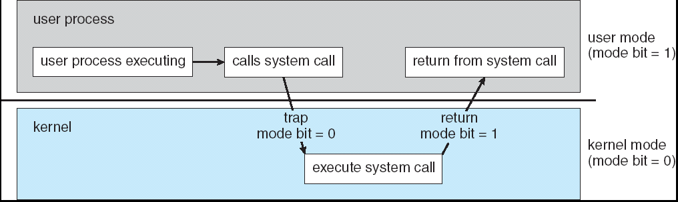
Recall: User→Kernel (System Call)
Can’t let inmate (user) get out of padded cell on own
Would defeat purpose of protection!
So, how does the user program get back into kernel?
System call: Voluntary procedure call into kernel
Hardware for controlled User→Kernel transition
Can any kernel routine be called?
No! Only specific ones.
System call ID encoded into system call instruction
Index forces well-defined interface with kernel
But on a page-fault there is no “system call” instruction

Slide 16
Transparent Exceptions: TLB/Page fault (1/2)
Faulting
Inst 1
Faulting
Inst 1
Faulting
Inst 2
Faulting
Inst 2
User
TLB Faults
OS
Software
Load TLB
Fetch page/
Load TLB
How to transparently restart faulting instructions?
(Consider load or store that gets TLB or Page fault)
Could we just skip faulting instruction?
No: need to perform load or store after reconnecting physical page

Slide 17
Transparent Exceptions: TLB/Page fault (2/2)
Faulting
Inst 1
Faulting
Inst 1
Faulting
Inst 2
Faulting
Inst 2
User
TLB Faults
OS
Software
Load TLB
Fetch page/
Load TLB
Hardware must help out by saving:
Faulting instruction and partial state
Need to know which instruction caused fault
Is single PC sufficient to identify faulting position????
Processor State: sufficient to restart user thread
Save/restore registers, stack, etc
What if an instruction has side-effects?

Slide 18
Consider weird things that can happen
What if an instruction has side effects?
Options:
Unwind side-effects (easy to restart)
Finish off side-effects (messy!)
Example 1: mov (sp)+,10
What if page fault occurs when write to stack pointer?
Did sp get incremented before or after the page fault?
Example 2: strcpy (r1), (r2)
Source and destination overlap: can’t unwind in principle!
IBM S/370 and VAX solution: execute twice – once read-only
What about “RISC” processors?
For instance delayed branches?
Example: bne somewhere ld r1,(sp)
Precise exception state consists of two PCs: PC and nPC (next PC)
Delayed exceptions:
Example: div r1, r2, r3 ld r1, (sp)
What if takes many cycles to discover divide by zero, but load has already caused page fault?

Slide 19
Precise Exceptions
Precise ⇒ state of the machine is preserved as if program executed up to the offending instruction
All previous instructions completed
Offending instruction and all following instructions act as if they have not even started
Same system code will work on different implementations
Difficult in the presence of pipelining, out-of-order execution, ...
MIPS takes this position
Imprecise ⇒ system software has to figure out what is where and put it all back together
Performance goals often lead to forsaking precise interrupts
system software developers, user, markets etc. usually wish they had not done this
Modern techniques for out-of-order execution and branch prediction help implement precise interrupts

Slide 20
Recall: TLB Organization
CPU
TLB
Cache
Memory
Needs to be really fast
Critical path of memory access
In simplest view: before the cache
Thus, this adds to access time (reducing cache speed)
Seems to argue for Direct Mapped or Low Associativity
However, needs to have very few conflicts!
With TLB, the Miss Time extremely high!
This argues that cost of Conflict (Miss Time) is much higher than slightly increased cost of access (Hit Time)
Thrashing: continuous conflicts between accesses
What if use low order bits of page as index into TLB?
First page of code, data, stack may map to same entry
Need 3-way associativity at least?
What if use high order bits as index?
TLB mostly unused for small programs

Slide 21
Basic Concept #5
If we use K bits out of an N bit address, how many of the 2^{N} “things” in the address space can re refer too?
Which ones?

Slide 22
Reducing translation time further
CPU
TLB
Cache
Memory
As described, TLB lookup is in serial with cache lookup:
Machines with TLBs go one step further: they overlap TLB lookup with cache access.
Works because offset available early
10
Virtual Address
V page no.
offset
TLB Lookup
V
Access
Rights
PA
P page no.
offset
Physical Address
10

Slide 23
Overlapping TLB & Cache Access (1/2)
Main idea:
Offset in virtual address exactly covers the “cache index” and “byte select”
Thus can select the cached byte(s) in parallel to perform address translation
virtual address
Virtual Page #
Offset
physical address
tag / page #
index
byte

Slide 24
Overlapping TLB & Cache Access
Here is how this might work with a 4K cache:
What if cache size is increased to 8KB?
Overlap not complete
Need to do something else. See CS152/252
Another option: Virtual Caches
Tags in cache are virtual addresses
Translation only happens on cache misses
TLB
assoc
lookup
4K Cache
32
index
1 K
20
10
2
4 bytes
page #
disp
00
Hit/
Miss
FN
=
FN
Data
Hit/
Miss

Slide 25
Putting Everything Together: Address Translation
Physical
Memory:
Virtual Address:
Virtual
P1 index
Virtual
P2 index
Offset
PageTablePtr
Physical Address:
Physical
Page #
Offset
Page Table
(1st level)
Page Table
(2nd level)

Slide 26
Putting Everything Together: TLB
Physical
Memory:
Virtual Address:
Virtual
P1 index
Virtual
P2 index
Offset
PageTablePtr
Physical Address:
Physical
Page #
Offset
Page Table
(1st level)
Page Table
(2nd level)
TLB:
…

Slide 27
Putting Everything Together: Cache
Physical
Memory:
Virtual Address:
Virtual
P1 index
Virtual
P2 index
Offset
PageTablePtr
Physical Address:
Physical
Page #
Offset
Page Table
(1st level)
tag
index
byte
cache:
Page Table
(2nd level)
tag:
block:
TLB:
…
…

Slide 28
Next Up: What happens when …
Process
virtual address
physical address
MMU
page#
PT
instruction
frame#
retry
page fault
offset
exception
frame#
Operating System
offset
update PT entry
Page Fault Handler
load page from disk
scheduler

Slide 29
Break

Slide 30
Where are all places that caching arises in OSes?
Direct use of caching techniques
TLB (cache of PTEs)
Paged virtual memory (memory as cache for disk)
File systems (cache disk blocks in memory)
DNS (cache hostname => IP address translations)
Web proxies (cache recently accessed pages)
Which pages to keep in memory?
All-important “Policy” aspect of virtual memory
Will spend a bit more time on this in a moment

Slide 31
Impact of caches on Operating Systems (1/2)
Indirect - dealing with cache effects (e.g., sync state across levels)
Maintaining the correctness of various caches
E.g., TLB consistency:
With PT across context switches ?
Across updates to the PT ?
Process scheduling
Which and how many processes are active ? Priorities ?
Large memory footprints versus small ones ?
Shared pages mapped into VAS of multiple processes ?

Slide 32
Impact of caches on Operating Systems (2/2)
Impact of thread scheduling on cache performance
Rapid interleaving of threads (small quantum) may degrade cache performance
Increase average memory access time (AMAT) !!!
Designing operating system data structures for cache performance

Slide 33
Working Set Model
As a program executes it transitions through a sequence of “working sets” consisting of varying sized subsets of the address space
Address
Time

Slide 34
Cache Behavior under WS model
1
new working set fits
Hit Rate
0
Cache Size
Amortized by fraction of time the Working Set is active
Transitions from one WS to the next
Capacity, Conflict, Compulsory misses
Applicable to memory caches and pages. Others ?

Slide 35
Another model of Locality: Zipf
Likelihood of accessing item of rank r is α 1/rª
Although rare to access items below the top few, there are so many that it yields a “heavy tailed” distribution
Substantial value from even a tiny cache
Substantial misses from even a very large cache

Slide 36
Demand Paging
Modern programs require a lot of physical memory
Memory per system growing faster than 25%-30%/year
But they don’t use all their memory all of the time
90-10 rule: programs spend 90% of their time in 10% of their code
Wasteful to require all of user’s code to be in memory
Solution: use main memory as cache for disk
Processor
Control
Caching
Tertiary
Storage
(Tape)
Second
Level
Cache
(SRAM)
Main
Memory
(DRAM)
Secondary
Storage
(Disk)
Datapath
On-Chip
Cache

Slide 37
Illusion of Infinite Memory (1/2)
∞
TLB
Page
Table
Physical
Memory
512 MB
Disk
500GB
Virtual
Memory
4 GB
Disk is larger than physical memory ⇒
In-use virtual memory can be bigger than physical memory
Combined memory of running processes much larger than physical memory
More programs fit into memory, allowing more concurrency

Slide 38
Illusion of Infinite Memory (2/2)
∞
TLB
Page
Table
Physical
Memory
512 MB
Disk
500GB
Virtual
Memory
4 GB
Principle: Transparent Level of Indirection (page table)
Supports flexible placement of physical data
Data could be on disk or somewhere across network
Variable location of data transparent to user program
Performance issue, not correctness issue

Slide 39
Since Demand Paging is Caching, Must Ask…
What is block size?
1 page
What is organization of this cache (i.e. direct-mapped, set-associative, fully-associative)?
Fully associative: arbitrary virtual → physical mapping
How do we find a page in the cache when look for it?
First check TLB, then page-table traversal
What is page replacement policy? (i.e. LRU, Random…)
This requires more explanation… (kinda LRU)
What happens on a miss?
Go to lower level to fill miss (i.e. disk)
What happens on a write? (write-through, write back)
Definitely write-back – need dirty bit!

Slide 40
Recall: What is in a Page Table Entry
What is in a Page Table Entry (or PTE)?
Pointer to next-level page table or to actual page
Permission bits: valid, read-only, read-write, write-only
Example: Intel x86 architecture PTE:
Address same format previous slide (10, 10, 12-bit offset)
Intermediate page tables called “Directories”
P: Present (same as “valid” bit in other architectures)
W: Writeable
U: User accessible
PWT: Page write transparent: external cache write-through
PCD: Page cache disabled (page cannot be cached)
A: Accessed: page has been accessed recently
D: Dirty (PTE only): page has been modified recently
L: L=1⇒4MB page (directory only). Bottom 22 bits of virtual address serve as offset
Page Frame Number
(Physical Page Number)
Free
(OS)
0
L
D
A
PCD
PWT
U
W
P
31-12
11-9
8
7
6
5
4
3
2
1
0

Slide 41
Demand Paging Mechanisms
PTE helps us implement demand paging
Valid ⇒ Page in memory, PTE points at physical page
Not Valid ⇒ Page not in memory; use info in PTE to find it on disk when necessary
Suppose user references page with invalid PTE?
Memory Management Unit (MMU) traps to OS
Resulting trap is a “Page Fault”
What does OS do on a Page Fault?:
Choose an old page to replace
If old page modified (“D=1”), write contents back to disk
Change its PTE and any cached TLB to be invalid
Load new page into memory from disk
Update page table entry, invalidate TLB for new entry
Continue thread from original faulting location
TLB for new page will be loaded when thread continued!
While pulling pages off disk for one process, OS runs another process from ready queue
Suspended process sits on wait queue
Cache

Slide 42
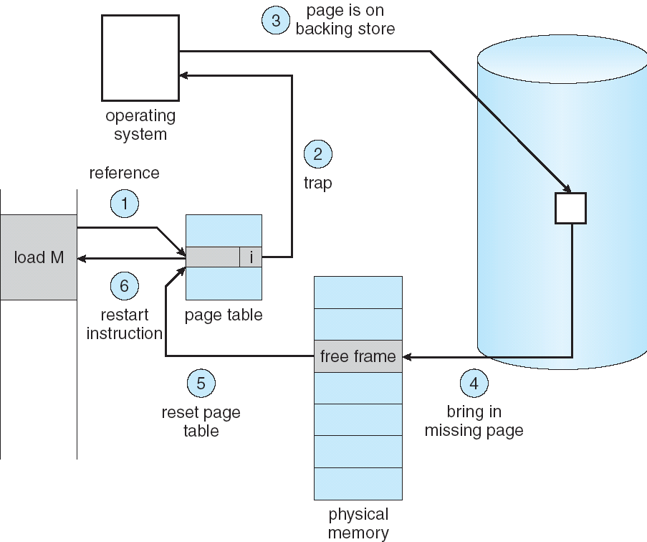
Summary: Steps in Handling a Page Fault

Slide 43
Summary
A cache of translations called a “Translation Lookaside Buffer” (TLB)
Relatively small number of PTEs and optional process IDs (< 512)
Fully Associative (Since conflict misses expensive)
On TLB miss, page table must be traversed and if located PTE is invalid, cause Page Fault
On change in page table, TLB entries must be invalidated
TLB is logically in front of cache (need to overlap with cache access)
Precise Exception specifies a single instruction for which:
All previous instructions have completed (committed state)
No following instructions nor actual instruction have started
Can manage caches in hardware or software or both
Goal is highest hit rate, even if it means more complex cache management
Notes:
No fancy replacement policy is needed for the direct mapped cache.
As a matter of fact, that is what cause direct mapped trouble to begin with: only one place to go in the cache--causes conflict misses.
No fancy replacement policy is needed for the direct mapped cache.
As a matter of fact, that is what cause direct mapped trouble to begin with: only one place to go in the cache--causes conflict misses.
Besides working at Sun, I also teach people how to fly whenever I have time.
Statistic have shown that if a pilot crashed after an engine failure, he or she is more likely to get killed in a multi-engine light airplane than a single engine airplane.
The joke among us flight instructors is that: sure, when the engine quit in a single engine stops, you have one option: sooner or later, you land. Probably sooner.
But in a multi-engine airplane with one engine stops, you have a lot of options. It is the need to make a decision that kills those people.

